Slide 1

Sensors
Module
Rohit Kumar

Slide 2
Contents
Title | Page
What is sensor?
Types of sensors
Temperature sensor
PIR Sensor
Light dependent resistor

Slide 3
What is Sensor?
A sensor is a device that measures a physical quantity and converts it into a signal which can be read by an observer or by an instrument.
Sensors are used in everyday objects such as touch-sensitive elevator buttons (tactile sensor) and lamps which dim or brighten by touching the base.
Applications include cars, machines, aerospace, medicine, manufacturing and robotics.

Slide 4

Temperature Sensor
Light dependent Resistance
Types of Sensors

Slide 5
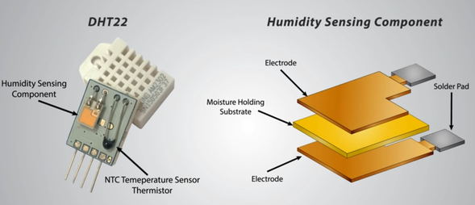
The DHT sensors can measure both temperature and humidity.
It consist of a humidity sensing component, a NTC temperature sensor (or thermistor) and an IC on the back side of the sensor.
For measuring humidity they use the humidity sensing component which has two electrodes with moisture holding substrate between them. So as the humidity changes, the conductivity of the substrate changes or the resistance between these electrodes changes. This change in resistance is measured and processed by the IC which makes it ready to be read by a microcontroller.
Temperature Sensor

Slide 6
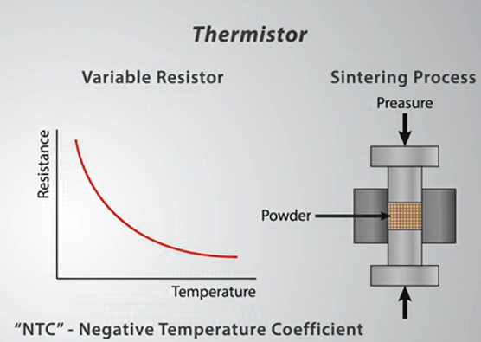
On the other hand, for measuring temperature these sensors use a NTC temperature sensor or a thermistor.
A thermistor is actually a variable resistor that changes its resistance with change of the temperature. These sensors are made by sintering of semi conductive materials such as ceramics or polymers in order to provide larger changes in the resistance with just small changes in temperature. The term “NTC” means “Negative Temperature Coefficient”, which means that the resistance decreases with increase of the temperature.

Slide 7
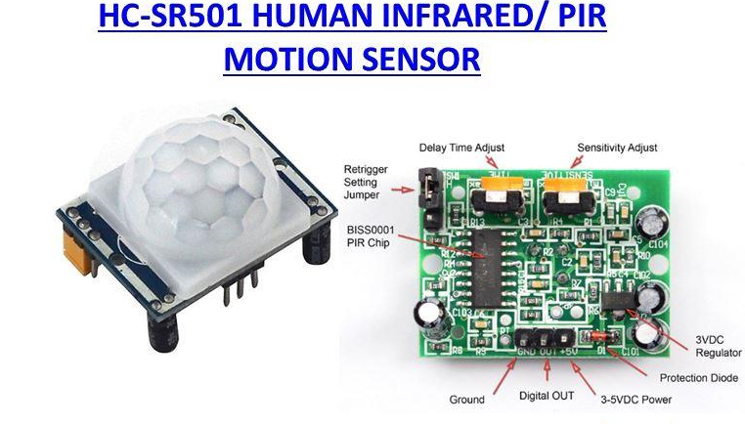
PIR Sensor
A PIR or a Passive Infrared Sensor can be used to detect presence of human beings in its proximity. The output can be used to control the alarm.
Basically motion detection use light sensors to detect either the presence of infrared light emitted from a warm object or absence of infrared light when a object interrupts a beam emitted by another part of the device.
A PIR sensor detects the infrared light radiated by a warm object. It consists of pyro electric sensors which introduce changes in their temperature (due to incident infrared radiation) into electric signal. When infrared light strikes a crystal, it generates an electrical charge.
Thus a PIR sensor can be used to detect presence of human beings within a detection area of approximately 14 meters.

Slide 8
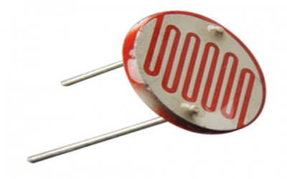
Light Dependent Resistor
A photoresistor or light dependent resistor is a component that is sensitive to light. When light falls upon it then the resistance changes. Values of the resistance of the LDR may change over many orders of magnitude the value of the resistance falling as the level of light increases.

Slide 9
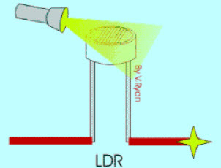
Types of photoresistor
Light dependent resistors, LDRs or photoresistors fall into one of two types or categories:
Intrinsic photoresistors: Intrinsic photoresistors use un-doped semiconductor materials including silicon or germanium. Photons fall on the LDR excite electrons moving them from the valence band to the conduction band. As a result, these electrons are free to conduct electricity. The more light that falls on the device, the more electrons are liberated and the greater the level of conductivity, and this results in a lower level of resistance.
Extrinsic photoresistors: Extrinsic photoresistors are manufactured from semiconductor of materials doped with impurities. These impurities or dopants create a new energy band above the existing valence band. As a result, electrons need less energy to transfer to the conduction band because of the smaller energy gap.
Regardless of the type of light dependent resistor or photoresistor, both types exhibit an increase in conductivity or fall in resistance with increasing levels of incident light.

Slide 10
Thank You !
Contact US
Nitin Sinha
nitin.sinha@goSigmaWay.com
+1 727-394-4375
+91 7838188809
Debjani Mitra
debjani.mitra@goSigmaWay.com
+1 952-583-3449
+91 9339555636
Rohit Kumar
rohit.kumar@sigmaway.us
+91 7982577830
+91 7838021754

